Slide 1


...YOU COULD TAKE A COPY OF YOUR DATA CENTRE TO SITE
WHAT IF..?

Slide 2
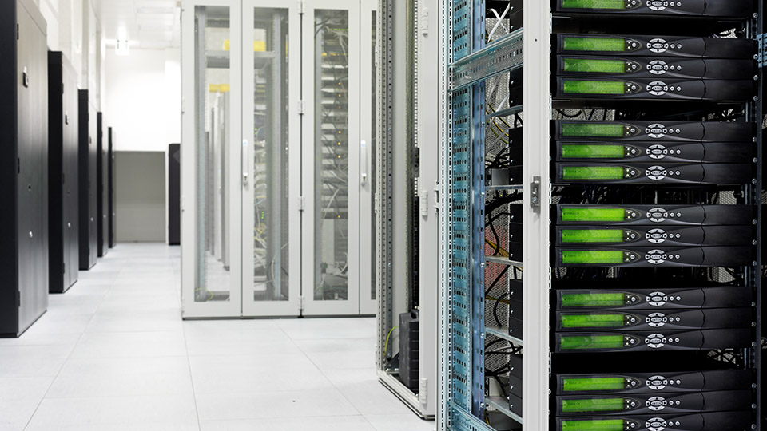

WHAT IF..?
…YOU COULD RUN YOUR SERVER ESTATE WITH ZERO COOLING

Slide 3
There is an increasing demand for cloud based infrastructure, flexible and mobile IT services and data security
Technical
Increasing and ever changing demand for IT services requires significant technical innovation to meet the demands of today's market
Social
The cost isn’t just a financial one – we need to consider the environment and the social demands on IT
Financial
As demand increases the cost of setting up, hosting and maintaining the services increases

Slide 4
Did you know..?
2018
3-4% of the global electricity supply is consumed by data centres
Experts predict data centres to consume three times as much energy in next decade
By 2018, Gartner estimates that the disaster recovery as a service market will be larger than the market for more traditional subscription-based DR services
By 2018, Gartner predicts 50% of enterprises will be using a hybrid cloud solution

Slide 5
Most companies are using traditional solutions to deliver the IT services they need
Technical
Static IT solutions, network and location based constraints, resource intensive infrastructure and difficult to support
Social
Pressure from increased activity away from HQ, more flexible workforce and demand for full IT services anywhere & anytime
Financial
High fixed costs, demand on space, growth restrictions and energy (including cooling) prices

Slide 6
Use our BioDigitalPC® range to help you meet today’s
IT Delivery challenges
£
Leading the way
Minimising costs
Becoming mobile
Reducing environmental impact

Slide 7


Use our BioDigitalPC® range to help you meet today’s
IT Delivery challenges
£
Leading the way
Minimising costs
Becoming mobile
Reducing environmental impact

Slide 8
The BioDigitalPC® 9 is the first fully functional, credit card sized x86 computer on the market
6.5 mm
84 mm
54 mm
See appendix for specs

Slide 9
Once it’s plugged into a docking station it’s ready to use as a powerful computer
Monitor
TV
Other types of docking stations
Keyboard
Laptop shell
BioDigitalPC® 9 in the Desktop 2.0

Slide 10
Or plug the BioDigitalPC® 9 cards into our mobile, local and enterprise data centre product range
MDC8
Up to 8 cards
MDC22
Up to 22 cards
SR90
Up to 90 cards

Slide 11
This scalable technology means we can offer innovative IT Services solutions for every business size
MDC8
The MDC8 is perfect for off site deployment or as an alternative to a server room for small businesses.
It is approximately the size of a shoe box.
See appendix for specs

Slide 12
This scalable technology means we can offer innovative IT Services solutions for every business size
MDC22 (data centre in a box)
The MDC22 (data centre in a box) is an alternative to server rooms and small data centres for medium businesses.
It is approximately the size of an airplane carry on suitcase.
See appendix for specs

Slide 13
This scalable technology means we can offer innovative IT Services solutions for every business size
SR90
The SR90 is a direct replacement for large scale / enterprise data centres and fits in a standard 2U rack with up to 90 servers on board
See appendix for specs

Slide 14
The BioDigitalPC® range can be used in a number of ways
For example:
BioDigitalPC® 9
University students travelling between buildings on campus
MDC8
Building sites having a copy of their data centre on site for easy immediate access to files and applications
MDC22
Businesses replacing a server room in an office block to free up space to other purposes
SR-90
Businesses using the SR-90 as swing kit for a data centre move, or using it for disaster recovery

Slide 15
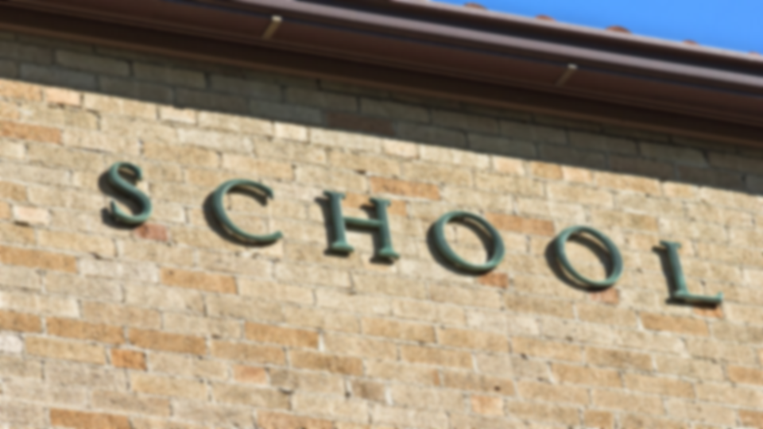
The BioDigitalPC® range can help you to massively reduce costs
£
Leading the way
Minimising costs
Becoming mobile
Reducing environmental impact

Slide 16
Our racks take up one eighth of the space of standard data centre racks, saving you money on premises…
SR-90
Standard Data Rack

Slide 17
…and they need much less power to run and don’t require chilled air cooling
The BioDigitalPC® uses 90% less power than a regular desktop and server
SR-90
runs off the equivalent of 20 x 100 watt light bulbs
MDC22 In a Box
runs off the equivalent power of 9 light bulbs
MDC8
runs off the equivalent power of 3 light bulbs
This means:

Slide 18
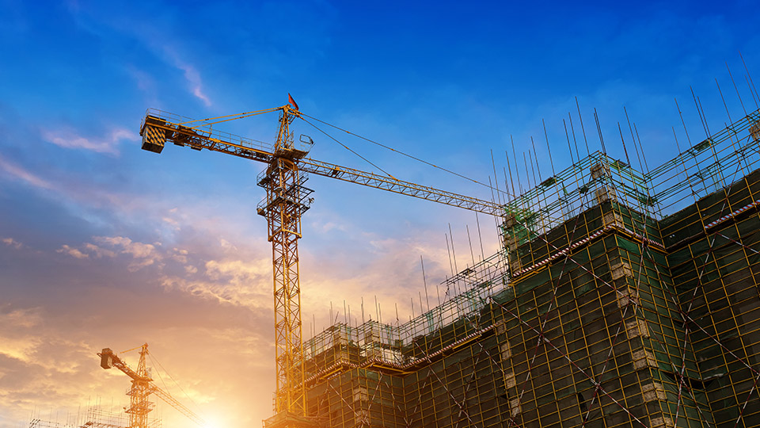
The BioDigitalPC® range will help your teams to work remotely and securely
£
Leading the way
Minimising costs
Becoming mobile
Reducing environmental impact

Slide 19

The BioDigitalPC® 9 means you can carry your entire computer in your wallet
10
10

Slide 20
Our mobile data centres allow you to easily carry services, applications and data to offsite locations

Slide 21
The BioDigitalPC® range is built to military specifications, making them extremely durable
Waterproof
Dustproof
Fire resistant
Available in commercial and industrial operating temperatures
Can withstand about
3,000G

Slide 22
The card incorporates a host of security features
Biometric
Fingerprint Reader
Trusted
Platform Module
Epoxy
Encapsulation

Slide 23

The BioDigitalPC® range will reduce your impact on the environment
£
Leading the way
Minimising costs
Becoming mobile
Reducing environmental impact

Slide 24
The BioDigitalPC® range requires less power than the alternatives, meaning a lower carbon footprint
A full rack of SR-90s will reduce daily carbon footprint by 1,000 tons of CO₂ compared to its current equivalent
SR-90
Standard Data Rack

Slide 25


When it comes time to upgrade, the only part you’ll need to replace is the card itself…
Previously…
Now…
SKIP
SKIP
(every few years)
(every few years)

Slide 26

…which can be recycled easily
You can even re-use cards used as servers in the MDC8, MDC22 and SR90 as a desktop computer

Slide 27
All products in the range are the same form factor meaning the support solution is unrivalled and simple
OFF

Slide 28
Our products have four key benefits:
Require minimal power
Do not require cooling
Increase available space
Highly mobile

Slide 29
Our products are extremely flexible. They’re…
Plug and Play
Reusable
Green
Forward/ Backward Compatible
Patented

Slide 30
Use our BioDigitalPC® range to help you meet today’s
IT Delivery challenges
£
Leading the way
Minimising costs
Becoming mobile
Reducing environmental impact

Slide 31
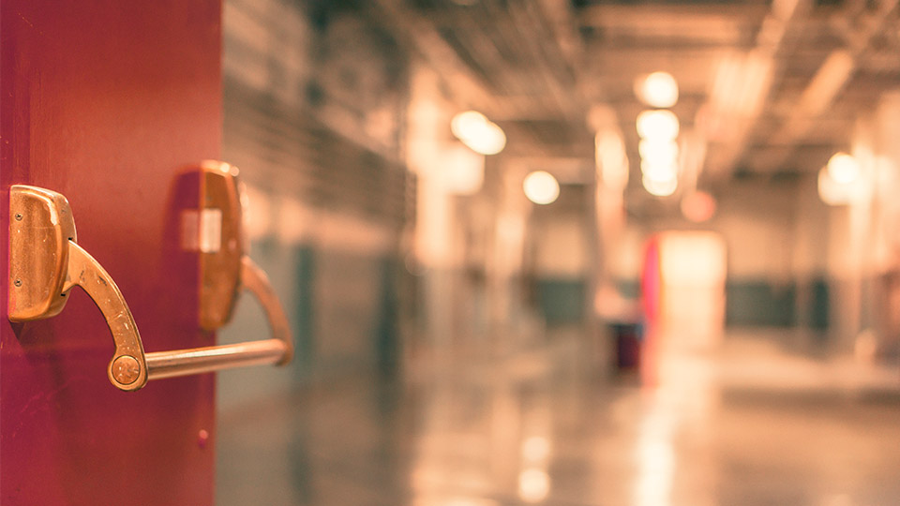
Appendix
Technical Specs

Slide 32
BioDigitalPC® 9 Spec
Tech Specs
1.46GHz single-core, 1.33GHz dual-core, or 1.91GHz quad-core Intel processor
2 to 8GB of DDR3 RAM
Powered by 5VDC and consumed between 5W and 10W
4 USB 2.0 and 1 USB 3.0
2 PCIe x1 Gen 2 and DisplayPort++: servicing DP, HDMI, DVI and VGA
Operating Temperature -40C to 110C
32GB to 128GB SSD
VT-x/Virtualization support
Trusted Platform Module

Slide 33
MDC8 Technical Spec
Tech Specs
Size: 7.12" x 13.25" x 8.62"(add 0.5" for rubber feet, add 1.37" for handle)
12-36VDC power input
Each Docking Station Provides:
  2 USB 2.0 connectors, 1 USB 3.0 connector
  Mini-DisplayPort (HDMI capable) connector
  Reset Button
Cisco RV325 Gigabit Router:
  Integrated dual WAN ports
  USB 2.0 port for 3G/4G LTE network backup
  6 additional internal Gb LAN ports available
Integrated Adaptec 6405E RAID Controller:
  RAID 0/1/JBOD Capable
  Comes with 4TB (2 x 2TB) SSD storage [optional 8TB (2x 4TB)]

Slide 34
MDC22 Technical DC in a BOX
Tech Specs
21.7" Length, 14.1" Width, 8.9" Depth
Approximately 45 lbs with 4 batteries and 22 BioDigitalPC®/MobylPC™'s
Power Input: 12-36 VDC or 85-264 VAC, 47-63Hz
System Includes:
  Up to 22 BioDigitialPC®/MobylPC™ Server Cards: 22-88 CPU cores, 88 CPU threads 44-176GB DDR3 RAM, up to 2.8TB on board SSD
  Up to 12TB optional storage
  Up to 4 hours of scaled out server uptime
  (4) 250 Wh UBI-2590 High Capacity SMBus Lithium-Ion Rechargeable Battery, NSN: 6140-01-611-019
  Each BioDigitalPC®/MobylPC™ docking station provides:
    (2) USB 2.0 connectors
    Mini-DisplayPort (HDMI capable) connector
    Red 5V power LED indicator
    Green Card Detect LED indicator

Slide 35
SR90
Tech Specs
2U retractable shelf server
90 to 360 CPU cores
180 to 720 DDR3 RAM
Up to 11.5TB on board SSD storage

